Slide 1
Blockchain Code Overview
Consensus Algorithms , POW/POS/POA
Distributed ledger
Blocks Wallets Transactions

Slide 2
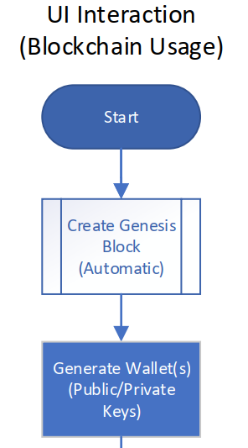

Slide 3
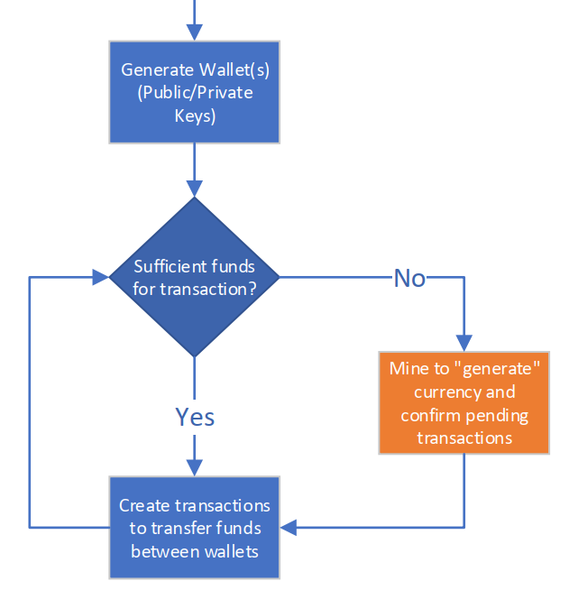

Slide 4
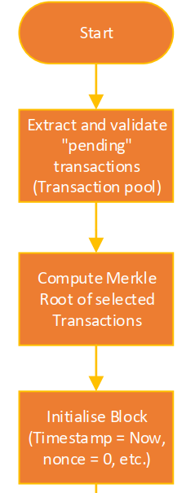

Slide 5
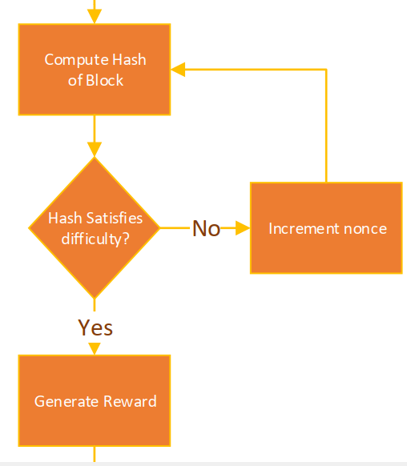

Slide 6
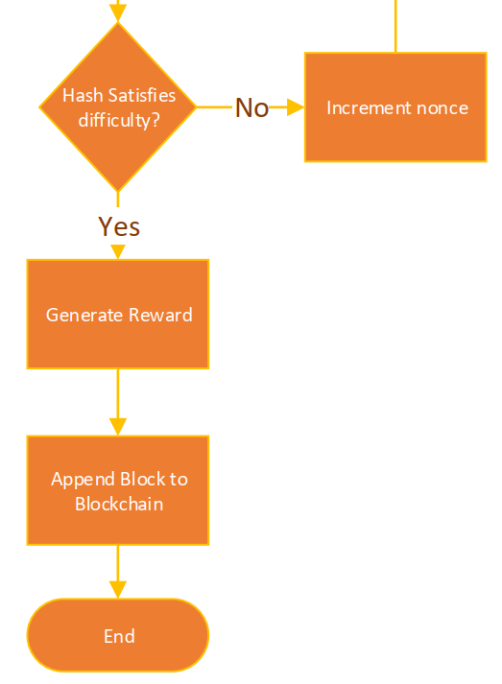

Slide 7
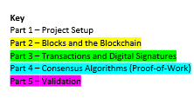
Blockchain Code Overview
Explanations of Implementation

Slide 8
BlockchainApp.cs

Slide 9
using System;
using System.Collections.Generic;
using System.Windows.Forms;
namespace BlockchainAssignment
{
public partial class BlockchainApp : Form
{
// Global blockchain object
private Blockchain blockchain;
// Default App Constructor
public BlockchainApp()
{
// Initialise UI Components
InitializeComponent();
// Create a new blockchain instance
this.blockchain = new Blockchain();
// Update UI with an initialisation message
UpdateText("New blockchain initialised!");
}
// Helper method to update the UI with a provided message “text”
private void UpdateText(String text)
{
output.Text = text;
}
// Print entire blockchain to UI for debugging
private void ReadAll_Click(object sender, EventArgs e)
{
UpdateText(blockchain.ToString());
}
// Print Block N (based on user specified index)
private void PrintBlock_Click(object sender, EventArgs e)
{
if (Int32.TryParse(blockNo.Text, out int index))
UpdateText(blockchain.GetBlockAsString(index));
else
UpdateText("Invalid Block No.");
}
// Print pending transactions from the transaction pool to the UI
private void PrintPendingTransactions_Click(object sender, EventArgs e)
{
UpdateText(String.Join("\n", blockchain.transactionPool));
}

Slide 10
/* WALLETS */
// Generate a new Wallet and fill the public and private key fields of the UI
private void GenerateWallet_Click(object sender, EventArgs e)
{
Wallet.Wallet myNewWallet = new Wallet.Wallet(out string privKey);
publicKey.Text = myNewWallet.publicID;
privateKey.Text = privKey;
}
// Validate the keys loaded in the UI by comparing their mathematical relationship
private void ValidateKeys_Click(object sender, EventArgs e)
{
if (Wallet.Wallet.ValidatePrivateKey(privateKey.Text, publicKey.Text))
UpdateText("Keys are valid");
else
UpdateText("Keys are invalid");
}
// Check the balance of current user
private void CheckBalance_Click(object sender, EventArgs e)
{
UpdateText(blockchain.GetBalance(publicKey.Text).ToString() + " Assignment Coin");
}
/* TRANSACTION MANAGEMENT */
// Create a new pending transaction and add it to the transaction pool
private void CreateTransaction_Click(object sender, EventArgs e)
{
Transaction transaction = new Transaction(publicKey.Text, reciever.Text, Double.Parse(amount.Text), Double.Parse(fee.Text), privateKey.Text);
blockchain.transactionPool.Add(transaction);
UpdateText(transaction.ToString());
}
/* BLOCK MANAGEMENT */
// Conduct Proof-of-work in order to mine transactions from the pool and submit a new block
private void NewBlock_Click(object sender, EventArgs e)
{
// Retrieve pending transactions to be added to the newly generated Block
List<Transaction> transactions = blockchain.GetPendingTransactions();
// Create and append the new block - requires a reference to the previous block, a set of // transactions and the miners public address (For the reward to be issued)
Block newBlock = new Block(blockchain.GetLastBlock(), transactions, publicKey.Text);
blockchain.blocks.Add(newBlock);
UpdateText(blockchain.ToString());
}

Slide 11
/* BLOCKCHAIN VALIDATION */
// Validate the integrity of the state of the Blockchain
private void Validate_Click(object sender, EventArgs e)
{
// CASE: Genesis Block - Check only hash as no transactions are currently present
if(blockchain.blocks.Count == 1)
{
if (!Blockchain.ValidateHash(blockchain.blocks[0])) // Recompute Hash to check validity
UpdateText("Blockchain is invalid");
else
UpdateText("Blockchain is valid");
return;
}
for (int i=1; i<blockchain.blocks.Count-1; i++)
{
if(
blockchain.blocks[i].prevHash != blockchain.blocks[i - 1].hash || // Check the chain of hashes (i.e. prev)
!Blockchain.ValidateHash(blockchain.blocks[i]) || // Check each blocks hash
!Blockchain.ValidateMerkleRoot(blockchain.blocks[i]) // Check transaction integrity using Merkle Root
)
{
UpdateText("Blockchain is invalid");
return;
}
}
UpdateText("Blockchain is valid");
}
}
}

Slide 12
Blockchain.cs

Slide 13
using System;
using System.Collections.Generic;
using System.Linq;
using System.Text;
using System.Threading.Tasks;
namespace BlockchainAssignment
{
class Blockchain
{
public List<Block> blocks; // List of block objects forming the blockchain
private int transactionsPerBlock = 5; // Maximum number of transactions per block
// List of pending transactions to be mined
public List<Transaction> transactionPool = new List<Transaction>();
// Default Constructor - initialises the list of blocks and generates the genesis block
public Blockchain()
{
this.blocks = new List<Block>(){
new Block() // Create and append the Genesis Block
};
}
// Prints the block at the specified index to the UI
public String GetBlockAsString(int index)
{
// Check if referenced block exists
if (index >= 0 && index < blocks.Count)
return blocks[index].ToString(); // Return block as a string
else
return "No such block exists";
}
// Retrieves the most recently appended block in the blockchain
public Block GetLastBlock()
{
return blocks[blocks.Count - 1];
}
// Retrieve pending transactions and remove from pool
public List<Transaction> GetPendingTransactions()
{
// Determine the number of transactions to retrieve dependent on the number of pending transactions and the limit specified
int n = Math.Min(transactionsPerBlock, transactionPool.Count);
// "Pull" transactions from the transaction list (modifying the original list)
List<Transaction> transactions = transactionPool.GetRange(0, n);
transactionPool.RemoveRange(0, n);
// Return the extracted transactions
return transactions;
}
// Output all blocks of the blockchain as a string
public override string ToString()
{
return String.Join("\n", blocks);
}
}

Slide 14
// Check validity of a blocks hash by recomputing the hash and comparing with the mined value
public static bool ValidateHash(Block block)
{
String rehash = block.CreateHash();
return rehash.Equals(block.hash);
}
// Check validity of the merkle root by recalculating the root and comparing with the mined value
public static bool ValidateMerkleRoot(Block block)
{
String reMerkle = Block.MerkleRoot(block.transactionList);
return reMerkle.Equals(block.merkleRoot);
}
// Check the balance associated with a wallet based on the public key
public double GetBalance(String address)
{
double balance = 0; // Accumulator value
// Loop through all approved transactions in order to assess account balance
foreach(Block block in blocks)
{
foreach(Transaction transaction in block.transactionList)
{
if (transaction.recipientAddress.Equals(address)
balance += transaction.amount; // Credit funds received
if (transaction.senderAddress.Equals(address))
balance -= (transaction.amount + transaction.fee); // Debit payments placed
}
}
return balance;
}

Slide 15
Block.cs

Slide 16
using System;
using System.Collections.Generic;
using System.Linq;
using System.Security.Cryptography;
using System.Text;
namespace BlockchainAssignment
{
class Block
{
private DateTime timestamp; // Time of creation
private int index, // Position of the block in the sequence of blocks
difficulty = 4; // An arbitrary number of 0's to proceed a hash value
public String prevHash, // A reference pointer to the previous block
hash, // The current blocks "identity"
merkleRoot, // The merkle root of all transactions in the block
minerAddress; // Public Key (Wallet Address) of the Miner
public List<Transaction> transactionList; // List of transactions in this block
// Proof-of-work
public long nonce; // Number used once for Proof-of-Work and mining
// Rewards
public double reward; // Simple fixed reward established by "Coinbase"
/* Genesis block constructor */
public Block()
{
this.timestamp = DateTime.Now;
this.index = 0;
this.transactionList = new List<Transaction>();
this.hash = Mine();
}
/* New Block constructor */
public Block(Block lastBlock, List<Transaction> transactions, String minerAddress)
{
this.timestamp = DateTime.Now;
this.index = lastBlock.index + 1;
this.prevHash = lastBlock.hash;
this.minerAddress = minerAddress; // The wallet to be credited the reward for the mining
this.reward = 1.0; // Assign a simple fixed value reward
transactions.Add(createRewardTransaction(transactions)); // Create and append the reward
this.transactionList = new List<Transaction>(transactions); // Assign provided transactions
this.merkleRoot = MerkleRoot(transactionList); // Calculate the merkle root of transactions
this.hash = Mine(); // Conduct PoW to create a hash which meets the given difficulty
}
/* Hashes the entire Block object */
public String CreateHash()
{
String hash = String.Empty;
SHA256 hasher = SHA256Managed.Create();
/* Concatenate all blocks properties including nonce as to generate new hash on each call */
String input = timestamp.ToString() + index + prevHash + nonce + merkleRoot;
/* Apply the hash function to the block as represented by the string "input" */
Byte[] hashByte = hasher.ComputeHash(Encoding.UTF8.GetBytes(input));
/* Reformat to a string */
foreach (byte x in hashByte)
hash += String.Format("{0:x2}", x);
return hash;
}

Slide 17
// Create a Hash which satisfies the difficulty level required for PoW
public String Mine()
{
nonce = 0; // Initalise the nonce
String hash = CreateHash(); // Hash the block
String re = new string('0', difficulty); // A string for analysing the PoW requirement
while(!hash.StartsWith(re)) // Check the resultant hash against the "re" string
{
nonce++; // Increment the nonce should the difficulty level not be satisfied
hash = CreateHash(); // Rehash with the new nonce as to generate a different hash
}
return hash; // Return the hash meeting the difficulty requirement
}
// Merkle Root Algorithm - Encodes transactions within a block into a single hash
public static String MerkleRoot(List<Transaction> transactionList)
{
List<String> hashes = transactionList.Select(t => t.hash).ToList();
if (hashes.Count == 0) // No transactions
return String.Empty;
if (hashes.Count == 1) // One transaction - hash with "self"
return HashCode.HashTools.combineHash(hashes[0], hashes[0]);
while (hashes.Count != 1) // Multiple transactions - Repeat until tree has been traversed
{
List<String> merkleLeaves = new List<String>(); // Keep track of current "level"
for (int i=0; i<hashes.Count; i+=2) // Step over neighbouring pair combining each
if (i == hashes.Count - 1)
merkleLeaves.Add(HashCode.HashTools.combineHash(hashes[i], hashes[i]));
else
merkleLeaves.Add(HashCode.HashTools.combineHash(hashes[i], hashes[i + 1]));
hashes = merkleLeaves; // Update the working "layer"
}
return hashes[0]; // Return the root node
}
// Create reward for incentivising the mining of block
public Transaction createRewardTransaction(List<Transaction> transactions)
{
double fees = transactions.Aggregate(0.0, (acc, t) => acc + t.fee); // Sum all fees
return new Transaction("Mine Rewards", minerAddress, (reward + fees), 0, ""); // Issue reward as a transaction in the new block
}
/* Concatenate all properties to output to the UI */
public override string ToString()
{
return "[BLOCK START]"
+ "\nIndex: " + index
+ "\tTimestamp: " + timestamp
+ "\nPrevious Hash: " + prevHash
+ "\n-- PoW --"
+ "\nDifficulty Level: " + difficulty
+ "\nNonce: " + nonce
+ "\nHash: " + hash
+ "\n-- Rewards --"
+ "\nReward: " + reward
+ "\nMiners Address: " + minerAddress
+ "\n-- " + transactionList.Count + " Transactions --"
+"\nMerkle Root: " + merkleRoot
+ "\n" + String.Join("\n", transactionList)
+ "\n[BLOCK END]";
}
}
}

Slide 18
Transaction.cs

Slide 19
/* Hash the transaction attributes using SHA256 */
public String CreateHash()
{
String hash = String.Empty;
SHA256 hasher = SHA256Managed.Create();
/* Concatenate all transaction properties */
String input = timestamp + senderAddress + recipientAddress + amount + fee;
Byte[] hashByte = hasher.ComputeHash(Encoding.UTF8.GetBytes(input));
foreach (byte x in hashByte)
hash += String.Format("{0:x2}", x);
return hash;
}
// Represent a transaction as a string for output to UI
public override string ToString()
{
return " [TRANSACTION START]"
+ "\n Timestamp: " + timestamp
+ "\n -- Verification --"
+ "\n Hash: " + hash
+ "\n Signature: " + signature
+ "\n -- Quantities --"
+ "\n Transferred: " + amount + " Assignment Coin"
+ "\t Fee: " + fee
+ "\n -- Participants --"
+ "\n Sender: " + senderAddress
+ "\n Reciever: " + recipientAddress
+ "\n [TRANSACTION END]";
}
}
}
namespace BlockchainAssignment
{
class Transaction
{
/* Transaction Variables */
DateTime timestamp; // Time of creation
public String senderAddress,
recipientAddress; // Participants public key addresses
public double amount, fee; // Quantities transferred
public String hash, signature; // Attributes for verification of validity
/* Transaction Constructor */
public Transaction(String from, String to, double amount, double fee, String privateKey)
{
this.timestamp = DateTime.Now;
this.senderAddress = from;
this.recipientAddress = to;
this.amount = amount;
this.fee = fee;
this.hash = CreateHash(); // Hash the transaction attributes
this.signature = Wallet.Wallet.CreateSignature(from, privateKey, hash);
// Sign the hash with the senders private key ensuring validity
}

